Slide 1
UPRS
Documentation department
OUTLINE MEMBERSHIP REQUIREMENT
REGISTRATION
MEMBERSHIP BENEFITS/ purpose
ROYALTY DISTRIBUTION

Slide 2
WHAT ARE THE REGISTRATION REQUIREMENTS FOR NATURAL PERSONS: (COMPOSERS – AUTHORS – PERFORMERS – PRODUCERS – PUBLISHERS)
1. Names and nationalities of the right owners.
2. A passport-size photographs.
3. A copy of the national identity card of the right owner;
4. Email address to individual create account.
5. FOR A MINOR - copy of an identity/passport/birth certificate for next of kin (if less than 16 years), he/she should be accompanied by A parent or A guardian who has A national identity card.
6. FOR GROUPS - names of group members & A nominated representative if it’s A group band choir.
7. Death certificate and letter of administration from the court of law if applying on behalf of A deceased person.
8. Bank account and mobile money account details of the applicant.
9. Each member must have mobile contact
10. The title of the works.
11. Copies of contracts/ agreements between the publisher / producer and the composers/authors/writers

Slide 3
WHAT ARE THE REGISTRATION REQUIREMENTS FOR LEGAL ENTITIES: (RECORD LABEL COMPANIES, AND PUBLISHING COMPANIES)
1. A copy of the certificate of incorporation or business name;
2. TIN certificate of registration.
3. Company form 20/company resolution
4.Trading license
5. The title of the works.
6. Copies of contracts/ agreements between the publisher / producer and the composers/authors/writers;
7. Names and nationalities of all directors or partners of the publishing record label company;
6. A copy of the national identity cards of the representative/S;
8. Preferred bank account number of the publishing / record label company.

Slide 4
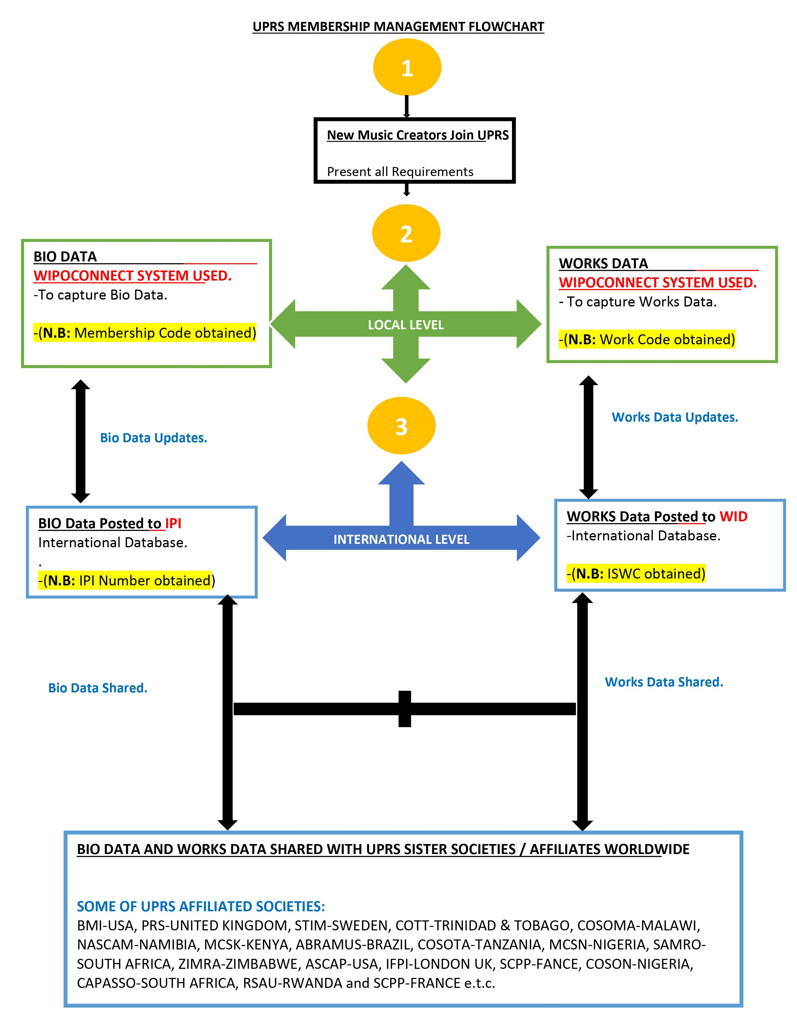

Slide 5
MEMBERSHIP BENEFITS/ REGISTRATION PURPOSE
WHAT ARE THE BENEFITS OF BEING A MEMBER OF UPRS
To generate IPI which is international identifier
UPRS provides confirmation letters to the members
Monitors when, where, and which members works are used.
Negotiation of tariffs with the users
Offers easier and faster access of members works legally
Legal representation or technical support in contractual agreements.
Collective bargaining on issues that affect members to government and other official bodies.
Participation in governance and leadership of UPRS.
Member benefit from royalty for all his/ her life time and 50 years after his death

Slide 6
ROYALTY DISTRIBUTION
Allocation split between musical works and sound recording.
Musical works is 60% of the net revenue.
Sound recording is 40% 0f the net revenue.
Royalty split between the interested parties
Musical works: We have,
author 25% of 60%, composer 25% of 60%, publisher 50% of 60%
Sound recording:
Performer 50% of 40% and producer 50% of 40%

Slide 7
Royalty split between the interested parties
Musical works:
Sound RECORDING:
60% of 100%
Composer 25%
Author 25%
Publisher 50%
40% of 100%
Performer 50%
Producer/ Record Label 50%

Slide 8
INTERNATIONAL REGULATORS
Confederation of international societies of authors and composers (CISAC)
World intellectual property organization (WIPO )
African regional intellectual property organization (ARIPO)

Slide 9
AFFILIATES/SISTER SOCIETIES
BMI- USA MSCN-NIGERIA
PRS – UNITED KINGDOM SAMRO-SOUTH AFRICA
COTT- TRINIDAD &TOBAGO ZIMRA-ZIMBABWE
STIM-SWEDEN RSAU- RWANDA
COSOMA-MALAWI IFPI-LONDON
NASCAM- NAMIBIA SCPP-FRANCE
MCSK – KENYA COSON-NIGERIA
ABRAMUS-BRAZIL ASCAP-USA
COSOTA-TANZANIA CAPASSO-SOUTH AFRICA

Slide 10
thank you
0

